Slide 1
Design Modeling: Design Class Diagram
Instructor: Mehroze Khan

Slide 2
Object-Oriented Design—The Bridge Between Analysis and Programming
Bridge between users’ requirements and new system’s programming
Object-oriented design is process by which detailed object-oriented models are built
Programmers use design to write code and test new system
User interface, network, controls, security, and database require design tasks and models

Slide 3
Object-Oriented Design Processes and Models
Diagrams developed for analysis/requirements
Use case diagrams and Use case descriptions
Activity diagrams
Domain model class diagrams
System sequence diagrams
Diagrams developed for design
Interaction diagrams and package diagrams
Design class diagrams – include object-oriented classes, navigation between classes, attribute names, method names, and properties needed for programming

Slide 4
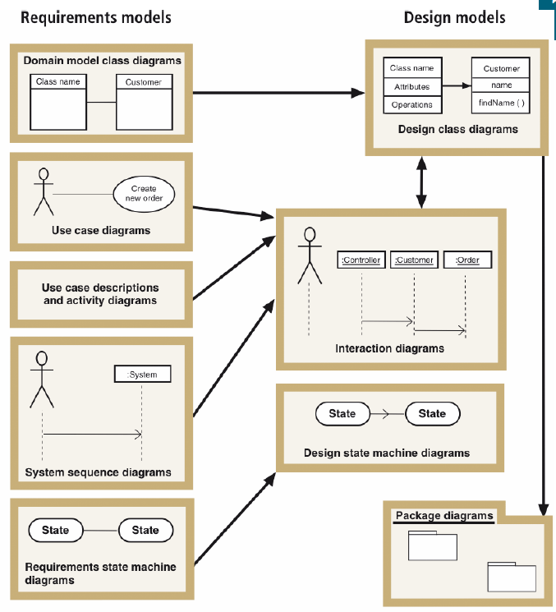
Design Models with Their Respective Input Models

Slide 5
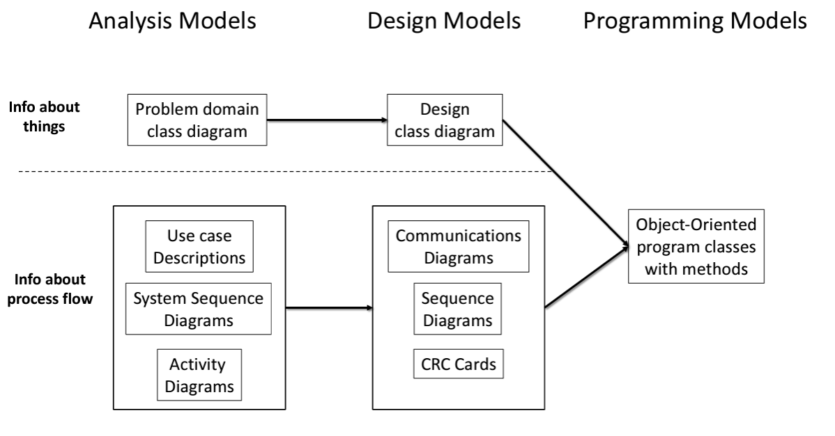

Slide 6
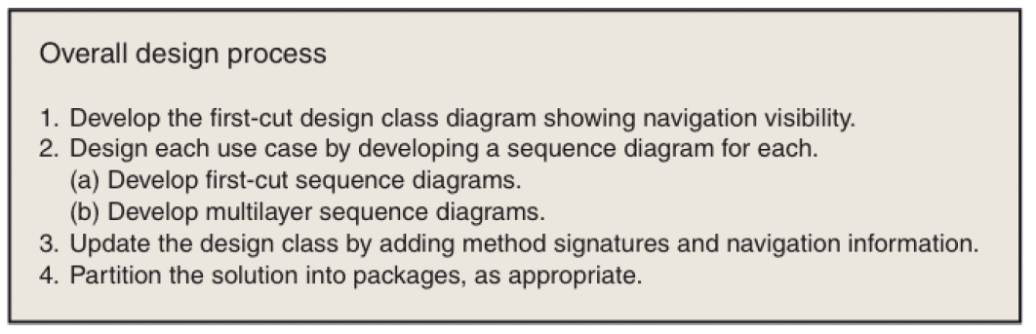
Iterative Process of OO Design - Design Steps

Slide 7
Design Classes, Interaction, and Design Process
Design class diagrams and detailed interaction diagrams use each other as inputs and are developed in parallel
First-cut design class diagram is based on domain model and system design principles
First-cut sequence diagram for use case is extended from system sequence diagram (SSD)
Shows interacting objects
Design class diagram is updated based on sequence diagram

Slide 8
Design Class Notation
Name – class name and stereotype information
Attribute visibility (private or public) – attribute name, type expression, initial-value, property
Method signature – information needed to invoke (or call) the method
Method visibility, method name, type-expression (return parameter), method parameter list (incoming arguments)
Overloaded method – method with same name but two or more different parameter lists
Class-level method – method associated with class instead of each object (static or shared method), denoted by an underline

Slide 9
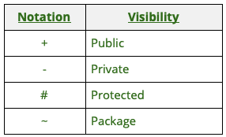
Visibility Symbols

Slide 10
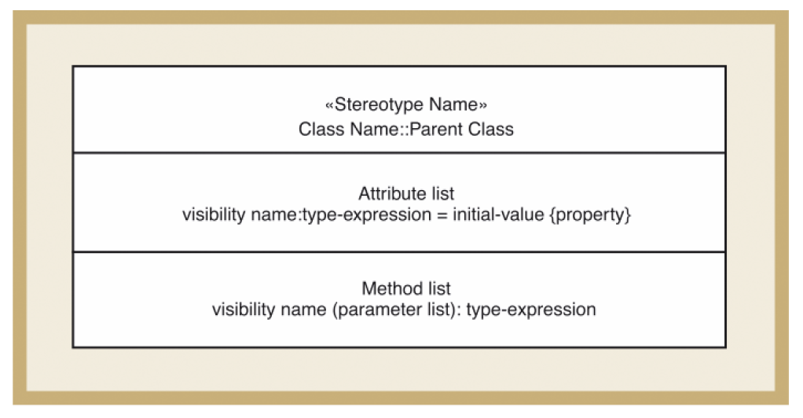
Notation Used to Define a Design Class

Slide 11
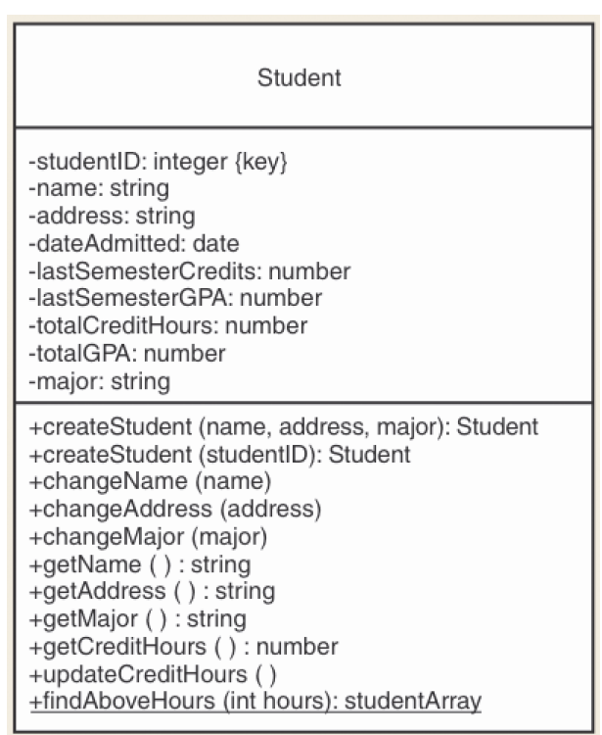
Student Design Class Example

Slide 12
Creating the Design Class Diagram
The following processes are done for each use case
Start with Analysis Models
In particular, the Domain Model Class Diagram
Need to add:
Types and visibility of attributes
Methods, parameters, and return types
Classes outside the user’s domain

Slide 13
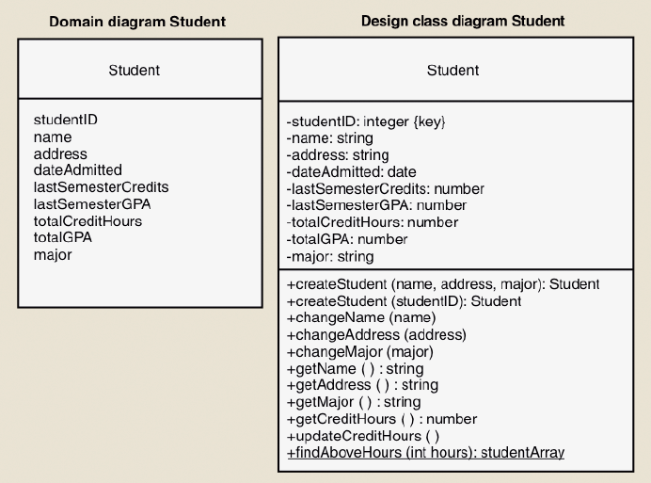
Student Class Examples for the Domain Class and the Design Class Diagrams
Elaborated Attributes
Method Signatures

Slide 14
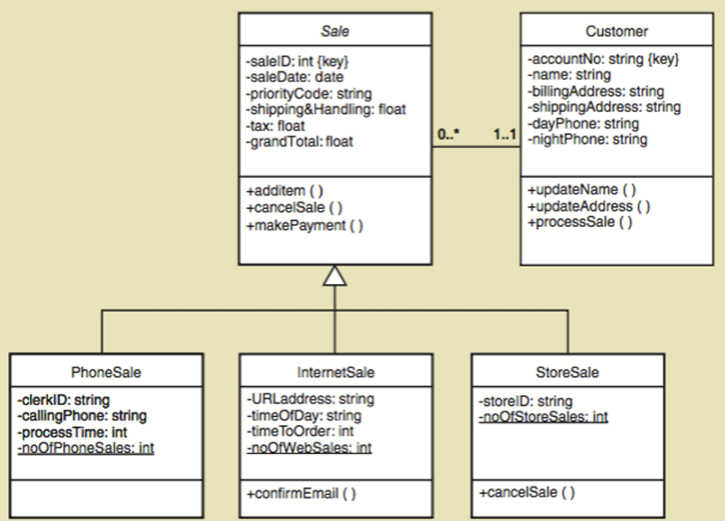

Slide 15
Developing First-Cut Design Class Diagram
Elaborate attributes
Navigation visibility
A design principle in which one object has a reference to another object and thus can interact with it
Can interact with other object by sending messages

Slide 16
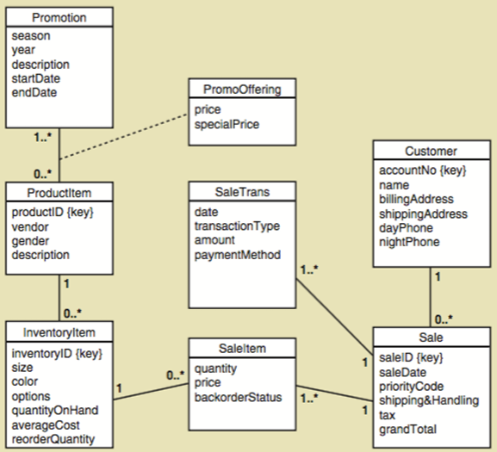

Slide 17
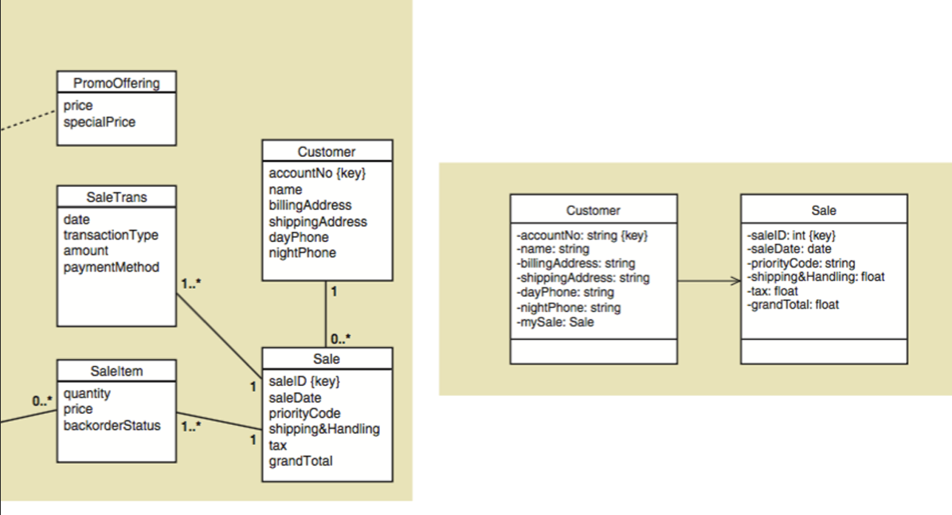

Slide 18
Adding Navigation Visibility
Identify:
1 to many relationships
If it is a superior/subordinate relationship, add visibility from superior to subordinate
Ex. From Sale to SaleItem
For Mandatory associations where one can’t live without the other
Add navigation from independent to dependent:
Ex. From Customer to Sale

Slide 19
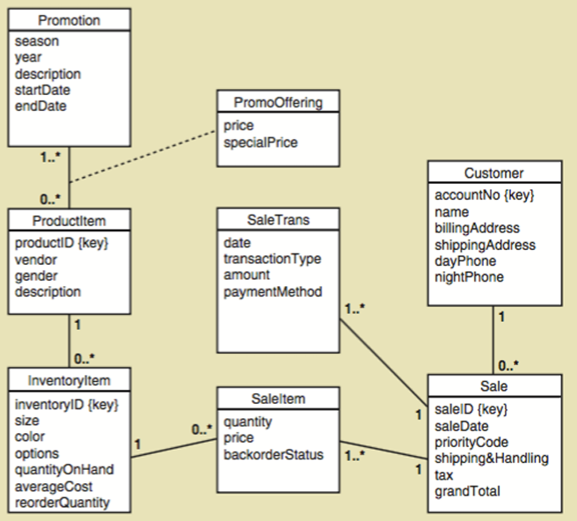
Figure Out Where Navigation Visibility Must be Added

Slide 20
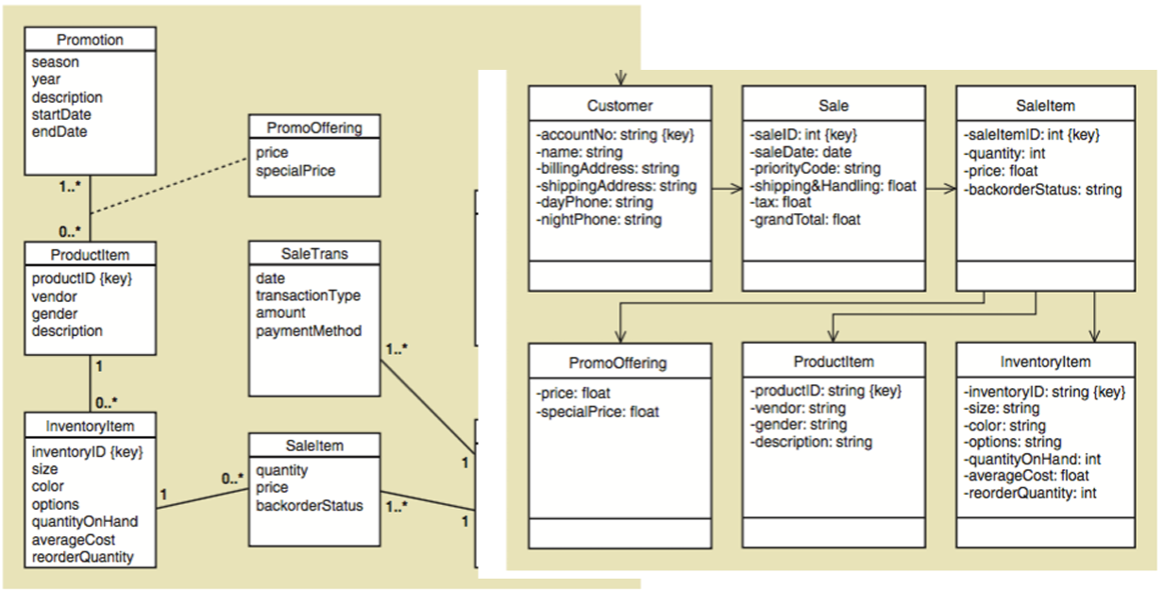

Slide 21
Building a First Cut Design Diagram
Next step:
Add a controller class to act as a switch board between input screens and programming logic classes

Slide 22
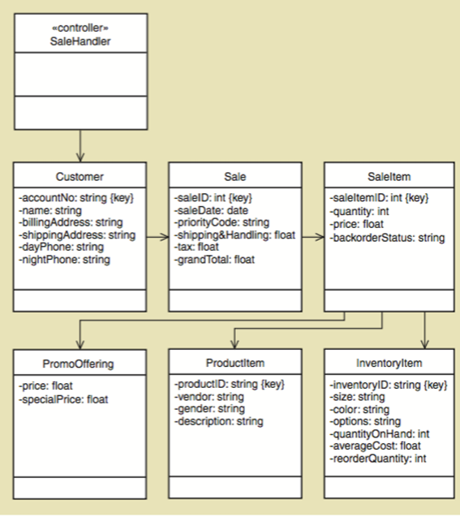

Slide 23
Developing the First-Cut Design Class Diagram
Extend domain model class diagram
Elaborate attributes with type and initial value information
Detailed design proceeds use case-by-use case
Interaction diagrams implement navigation
Navigation arrows are updated to be consistent
Method signatures are added to each class

Slide 24
Developing the First-Cut Design Class Diagram
Choose classes involved with the use case
Add use case controller
Elaborate attributes
Visibility, type-expression, initial-value, property
Establish first-cut navigation visibility
One-to-many relationships usually navigated from superior to subordinate
Mandatory relationships usually navigated from independent to dependent
When an object needs information from another object, navigation arrow points to the object itself or to its parent in hierarchy
Navigation can be in both directions (arrows bidirectional)

Slide 25
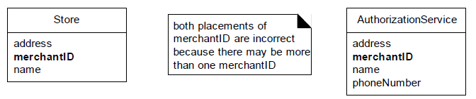
Association Classes
The following domain requirements set the stage for association classes:
Authorization services assign a merchant ID to each store for identification during communications.
A payment authorization request from the store to an authorization service needs the merchant ID that identifies the store to the service.
Furthermore, a store has a different merchant ID for each service.
Where in the Domain Model should the merchant ID attribute reside?
Placing merchantID in Store is incorrect because a Store can have more than one value for merchantID. The same is true with placing it in Authorization-Service

Slide 26
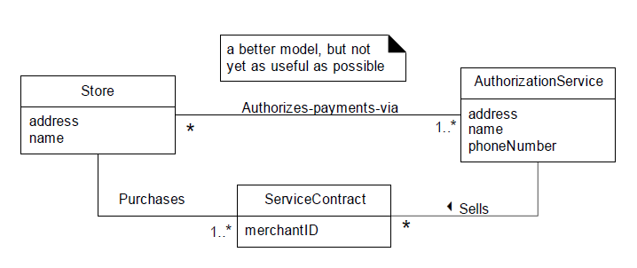
Association Classes
This leads to the following modeling principle:
In a domain model, if a class C can simultaneously have many values for the same kind of attribute A, do not place attribute A in C. Place attribute A in another class that is associated with C.
For example:
A Person may have many phone numbers. Place phone number in another class, such as PhoneNumber or ContactInformation, and associate many of these to Person.
Notes:
In the business world, what concept formally records the

Slide 27
Association Classes
In the business world, what concept formally records the information related to the services that a service provides to a customer?—a Contract or Account.
The fact that both Store and AuthorizationService are related to ServiceContract is a clue that it is dependent on the relationship between the two.
The merchantID may be thought of as an attribute related to the association between Store and AuthorizationService.
This leads to the notion of an association class, in which we can add features to the association itself. ServiceContract may be modeled as an association class related to the association between Store and AuthorizationService.

Slide 28
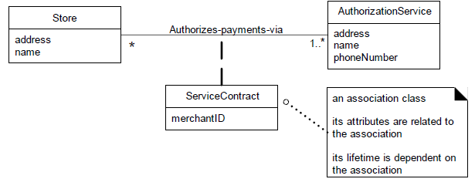
Association Classes
In the UML, this is illustrated with a dashed line from the association to the association class.
Figure visually communicates the idea that a Service-Contract and its attributes are related to the association between a Store and AuthorizationService, and that the lifetime of the ServiceContract is dependent on the relationship.

Slide 29
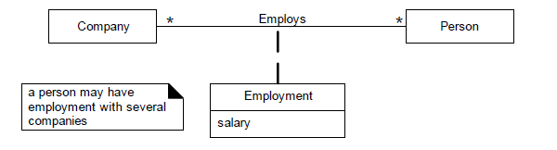
Association Classes
Clues that an association class might be useful in a domain model:
An attribute is related to an association.
Instances of the association class have a life-time dependency on the association.
There is a many-to-many association between two concepts, and information associated with the association itself.

Slide 30
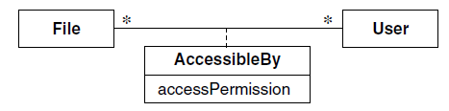
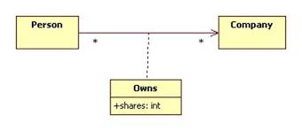
Association Classes

Slide 31
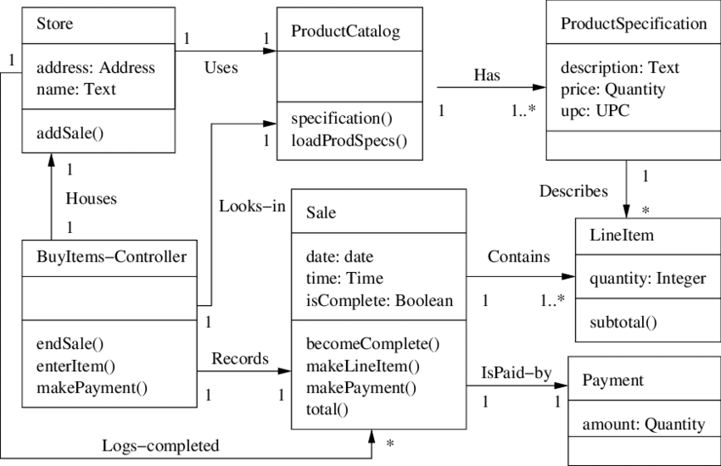
Design Class Diagram

Slide 32
References
Satzinger, John W., Robert B. Jackson, and Stephen D. Burd. Systems analysis and design in a changing world. 4th Edition.
Larman, Craig. Applying UML and patterns: an introduction to object oriented analysis and design and interative development. Pearson Education India, 2012.
Object-Oriented Modeling and Design with UML, Michael R. Blaha and James R. Rumbaugh, 2nd Edition, Pearson, 2005.

